Slide 1
Health Outcome Measurement in Economic Evaluation
August 28, 2025
Tabitha Okech
Center for Epidemiological Modelling and Analysis

Slide 2
Outline
P.2
Types of outcome used in health economic evaluation
Outcome measure in cost-effectiveness analysis
  Efficacy VS Effectiveness
  Intermediate VS Final health outcome
  Measurement of Treatment effects
Outcome measure in cost utility analysis
  Quality Adjusted Life Year (QALY)
  Disability Adjusted Life Years (DALYs)
  Methods for assessing utility value (VAS, SG, TTO, EQ-5D-5L)

Slide 3



Economic Evaluations
Intervention A
Outcome
Cost
Intervention B
Outcome Cost
✔ Comparison of the costs and outcomes of alternative policy options.
✔ Additional unit of resources spent per additional unit of outcome gained

Slide 4








Type of health outcomes
Clinical e.g., reduce risk, length of stay, cure rate, mortality
Humanistic e.g., health-related quality of life
Economic (monetary value)
Notes:
Natural units – These are direct clinical outcomes, such as: Life-years gained, Cases prevented (e.g., malaria cases averted), Deaths averted, Hospitalizations avoided
Summary health measures – These combine both quantity and quality of life, such as:
QALYs (Quality-Adjusted Life Years) – incorporates both length of life and quality of health.
DALYs (Disability-Adjusted Life Years) – measures the burden of disease, with lower DALYs meaning better health outcomes.
Incremental Cost-Effectiveness Ratio (ICER)

Slide 5
Outline
P.7
Types of outcome used in health economic evaluation
Outcome measure in cost effectiveness analysis
  Clinical outcomes: Efficacy VS Effectiveness
  Intermediate VS Final health outcome
  Measurement of Treatment effects
Outcome measure in cost utility analysis
  Quality Adjusted Life Year (QALY)
  Disability Adjusted Life Years (DALYs)
  Methods for assessing utility value (VAS, SG, TTO, EQ-5D-5L)

Slide 6
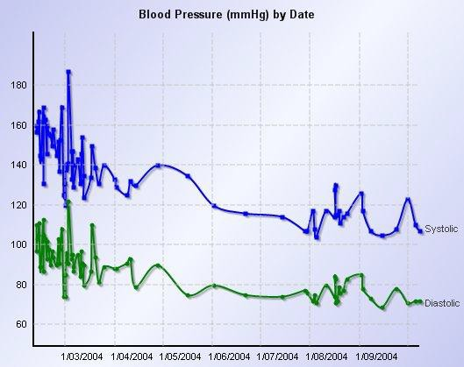
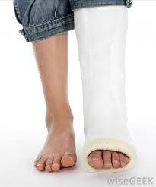
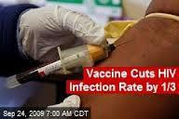
Unit of outcome measurement in cost-effectiveness analysis
P.8
Clinical outcome in natural unit

Slide 7
Examples of “Clinical outcome”
Treatment/ intervention | Outcome
Malaria treatment | Number of cases prevented
Hypercholesterolemia drug | Life year gained % reduction in LDL % increase in HDL
Glaucoma treatment | Reduction of intra-ocular pressure, year of avoided visual disability
Osteoporosis treatment | Number of fracture prevented
Asthma treatment | Episode free day

Slide 8
Pros and Cons of using “Clinical” outcomes
PRO
Can be easily measured and well understood by health care professionals
CON
Different types of “clinical” outcome can’t be compared e.g.,
𝐶𝑎𝑟𝑑𝑖𝑜𝑣𝑎𝑠𝑐𝑢𝑙𝑎𝑟 𝑑𝑖𝑠𝑒𝑎𝑠𝑒 ≠ 𝐶𝑎𝑛𝑐𝑒𝑟.
May not be appropriate if drug/intervention resulted in several aspect of outcomes.

Slide 9
Efficacy VS Effectiveness
P.11
Efficacy: A clinical outcome derived from patients’ use of pharmaceutical product or health technology, typically Randomized Control trial Phase III. Main concern is validity.
“Can it work under ideal conditions?”
Effectiveness: How well a treatment or health technology performs under real world conditions outside the context of a randomised trial where the experiment no longer hold. Main concern is generalizability or transferability.
“Does it work under real circumstances?”

Slide 10
Final VS intermediate outcome
Final outcome: Death, loss of vision, MI, CHD death, LYG, QALY, DALY
  Limitation: long duration; expensive
Intermediate outcome: CD4 cell count, Blood pressure, cholesterol level, microalbuminuria, other laboratory measures
  Advantages: short duration, not expensive
  Limitation: Disease process could affect the clinical outcome through several causal pathway!

Slide 11
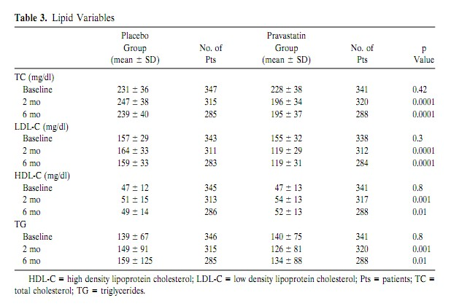

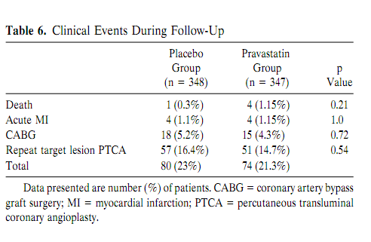
I n t e r m e d o u t c o m e
i
F i n a l
o u t c o m e

Slide 12
Measurement of Treatment effects
Outcomes of the treatment and prevention interventions
  Relative risk / Risk ratio (RR)
  Odds ratio (OR)
Outcomes of the screening and diagnosis interventions
  Sensitivity
  Specificity
14

Slide 13
Recap
Relative risk (RR) : probability of an event occurring in an exposed group to the probability of the same event occurring in a non-exposed group
₌ Incidence in treatment group
Incidence in control group
Odds ratio (OR): measures the association of an outcome by comparing the odds of an outcome occurring in an exposed group compared to non-exposed
            ₌ Odds in treatment group
Odds in control group

Slide 14
Sensitivity and Specificity
 |  | Gold standard
 |  | Disease | No disease | Total
Test result | Positive | a (True positive) | b (False positive) | a + b
 | Negative | c (False negative) | d (True negative) | c + d
 | Total | a + c | b + d
 |  | 𝑎 Sensitivity = 𝑎 + 𝑐 𝑡𝑟𝑢𝑒 𝑝𝑜𝑠𝑖𝑡𝑖𝑣𝑒 = 𝑑𝑖𝑠𝑒𝑎𝑠𝑒 | 𝑑 Specificity = b + 𝑑 𝑡𝑟𝑢𝑒 𝑛𝑒𝑔𝑎𝑡𝑖𝑣𝑒 ⁼ 𝑛𝑜 𝑑𝑖𝑠𝑒𝑎𝑠𝑒 | 𝑎 + 𝑑 Accuracy = a + b + 𝑐 + 𝑑 𝑐𝑜𝑟𝑟𝑒𝑐𝑡 𝑝𝑟𝑒𝑑𝑖𝑐𝑡𝑖𝑜𝑛 ⁼ 𝑡𝑜𝑡𝑎𝑙
16

Slide 15
Outline
P.17
Types of outcome used in health economic evaluation
Outcome measure in cost effectiveness analysis
  Efficacy VS Effectiveness
  Intermediate VS Final health outcome
  Measurement of Treatment effects
Outcome measure in cost utility analysis
  Quality Adjusted Life Year (QALY)
  Disability Adjusted Life Years (DALYs)
  Methods for assessing utility value (VAS, SG, TTO, EQ-5D-5L)
Exercise

Slide 16

Unit of outcome measurement
in cost-utility analysis
Common Unit
  Quality-adjusted life years (QALYs)
  Disability adjusted life years (DALYs)

Slide 17
QALY vs. DALY
Quality Adjusted Life Years: QALYs
  are years of a healthy life lived.
Disability Adjusted Life Years: DALYs
  are years of healthy life lost.

Slide 18
QALYs

Slide 19

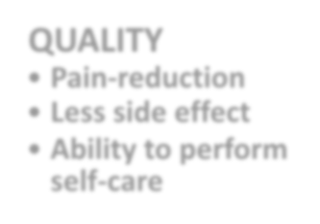







Concept of Quality-adjusted life years (QALYs)
QUANTITY
Life years gained
QUALITY
Pain-reduction
Less side effect
Ability to perform self-care
QALYs
EFFECTS of the intervention
21

Slide 20
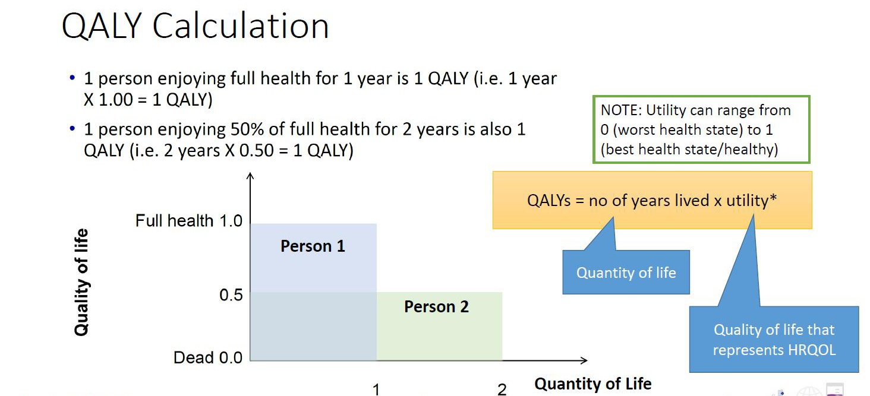

Slide 21
DALYs

Slide 22
About the Global Burden Disease (GBD)
First conducted in 1990 by the World Bank in the run up to the World Development Report.
The initiative “quantified the health effects of more than 100 diseases and injuries for eight regions of the world in 1990”.
First study conducted by WHO/Harvard School of Public Health. Now led by Institute for Health Metrics and Evaluation at the University of Washington with WHO and other partners.
Most recent update is as of 2021.
Source: WHO

Slide 23
DALYs
Disability adjusted life years (DALYs): “a single measure to quantify the burden of diseases, injuries and risk factors”.
Compares losses in health against a reference point (1 = death, 0= perfect health)
Calculation:
DALY = YLL + YLD
Where: YLL = Years of life lost, YLD = Years lived with disability And:
YLL = Number of deaths x standard life expectancy at age of death in years YLD = Number of prevalent cases x Disability weights
Source: WHO

Slide 24
Application of DALYs
Used as a health measure in economic evaluations
Interpretation: Interventions that increase the number of DALYs averted are better (live less with disability)
Easy to use for countries where there is no local data on QALYs
Tools for usability of data in decision making
DALYs enable comparisons of the burden of different diseases and conditions within a population

Slide 25
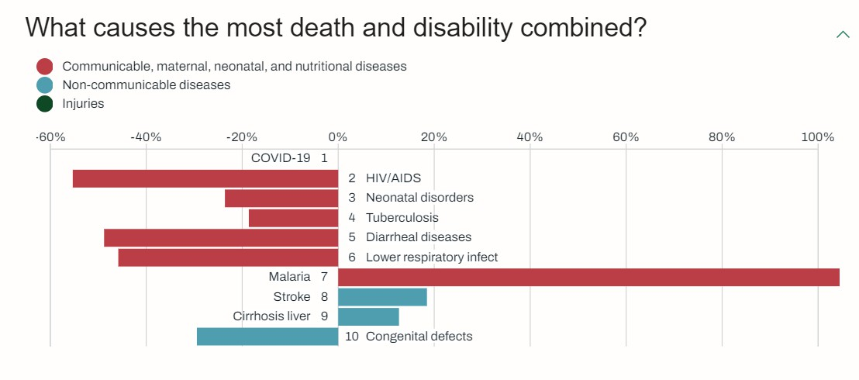
Kenya’s disease burden in 2021
Source: https://www.healthdata.org/research-analysis/health-by-
location/profiles/kenya

Slide 26
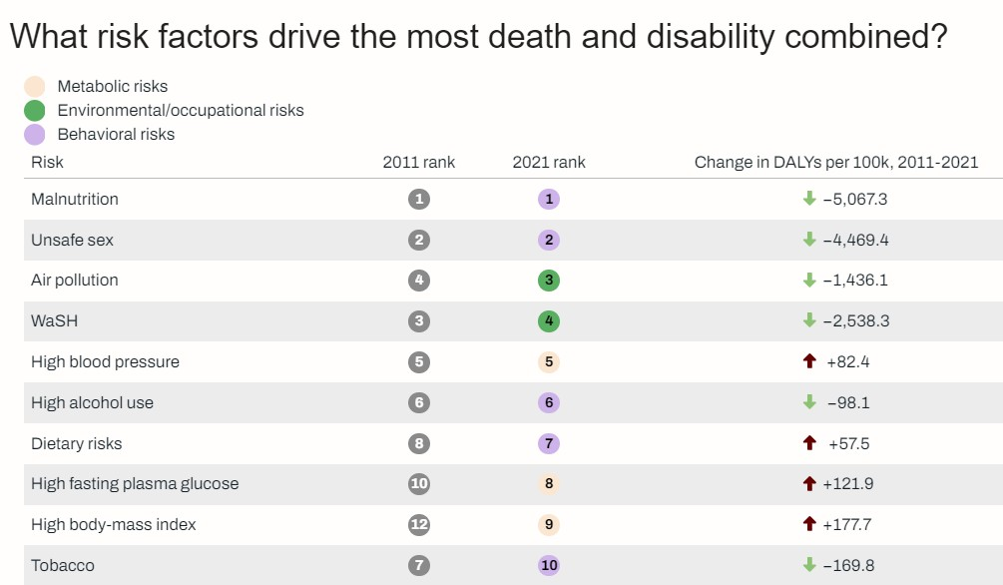
Kenya’s disease burden in 2021
Source: https://www.healthdata.org/research-analysis/health-by-
location/profiles/kenya

Slide 27
QALY vs. DALY
QALYs and DALYs are both valuable metrics for evaluating health outcomes, each with its unique applications and advantages.
QALYs are more suited for individual-level evaluations and cost-utility analysis.
DALYs are more suited for population-level assessments and global health policy and commonly used by global health organizations like the World Health Organization (WHO) to prioritize healthcare resources and policies.

Slide 28
Utility: Valuation techniques
Direct methods • Indirect methods
Visual analogue scale (VAS)
Standard gamble (SG)
Time trade-off (TTO)
Preference-based measure
  EQ-5D-5L
  SF-6D
  HUI3
Mapping (crosswalk)
30

Slide 29
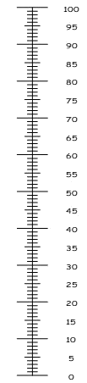

Visual Analogue Scale
P.31
Perfect health
Scale of 0 – 100
100 = the perfect health state in your opinion
0 = the worst health state in your opinion
X = where you rate your health state
Utility value = X/100
X
X = 80
U = 80/100
= 0.8
U = X/100
Worst state = death
29

Slide 30
Standard gamble
P.32
The subject is offered 2 alternatives to choose from:
Choice A: A gamble with a probability p of achieving perfect health and a probability 1−p of
immediate death.
Choice B: : A certain outcome of living in a chronic health state (e.g., dialysis) for the rest of their life.
Probability p is varied (0.8, 0.7, …, 0.5, 0.45, …) until the respondent is indifferent between the the certain outcome and the gamble. This indifference probability, p, is the utility value for health state A in the utility value between death (0) and full health (1).
Utility of health state A = P
30

Slide 31
Standard Gamble
Alternative a
Perfect health
(p)
Death
(1-p)
Chronic health state A
Alternative b
Utility (of chronic health state A) = p
31

Slide 32
Time trade-off
The subject is asked to choose between 2 choices:
Choice 1: Being in health state A ( e.g., cancer) for t years followed by death.
Choice 2: Being in “full health” for a period of X years (where X<t ) followed by death.
Time x is varied until the respondent is indifferent between the two alternatives, at which point the preference value for health state A is given by X/t in the value between death (0) and full health (1)
Utility of health state A = X/ t
32

Slide 33
Time Trade Off
Choice 2
healthy
Choice 1
state i
Dead
utility
x
t
TIME
U_{i} = x/t
33

Slide 34
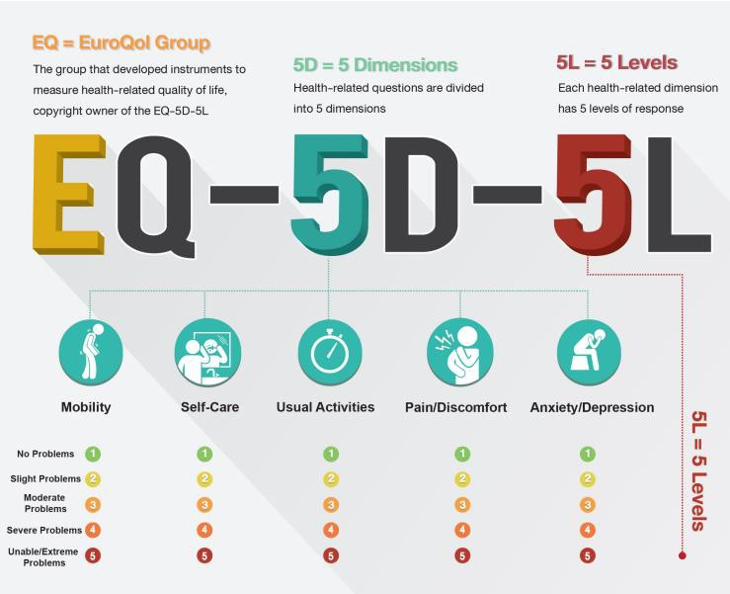
EQ-5D-5L
Health Questionnaire

Slide 35
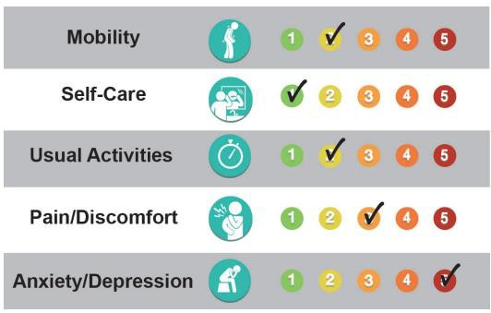
Using the EQ-5D-5L
Level 1 means no problems Level 2 means slight problems Level 3 means moderate
problems
Level 4 means severe problems
Level 5 means unable to partake in that activity, or extreme problems
EQ-5D-5L = 21235
35

Slide 36
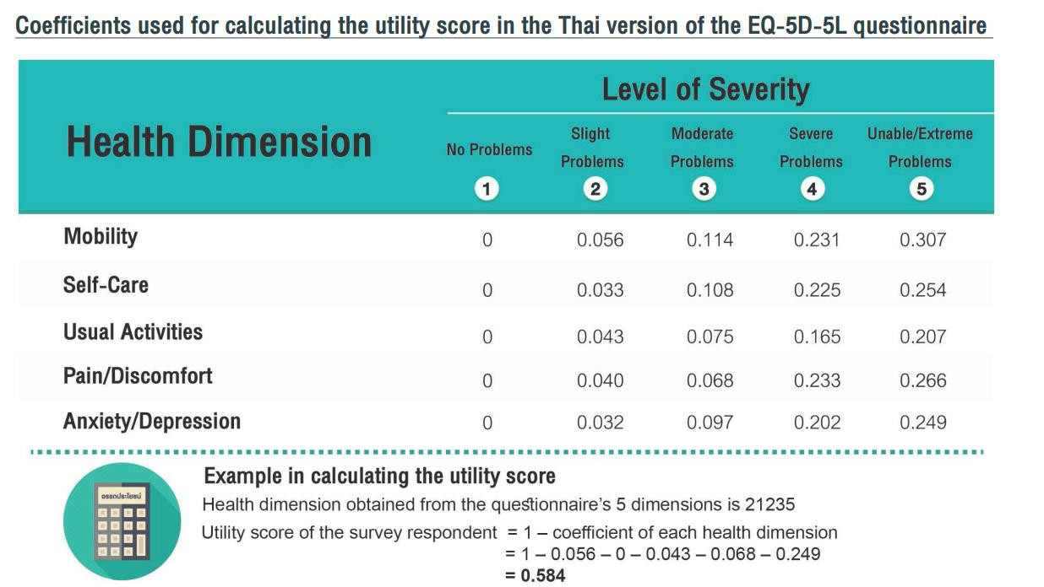
36

Slide 37
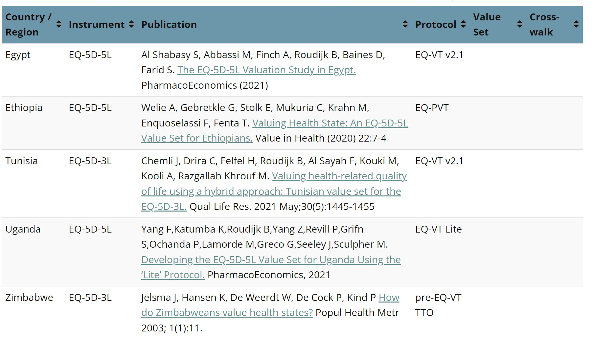
More information on EQ-5D
Questionnaires/instr uments
  EQ-5D-5L
  EQ-5D-3L
  EQ-5D-Y-3L
Value sets
  Index values of all
possible states
  Derived from a standardised valuation exercise, representativeof the population
Value sets in Africa
Value sets | EuroQol
37

Slide 38
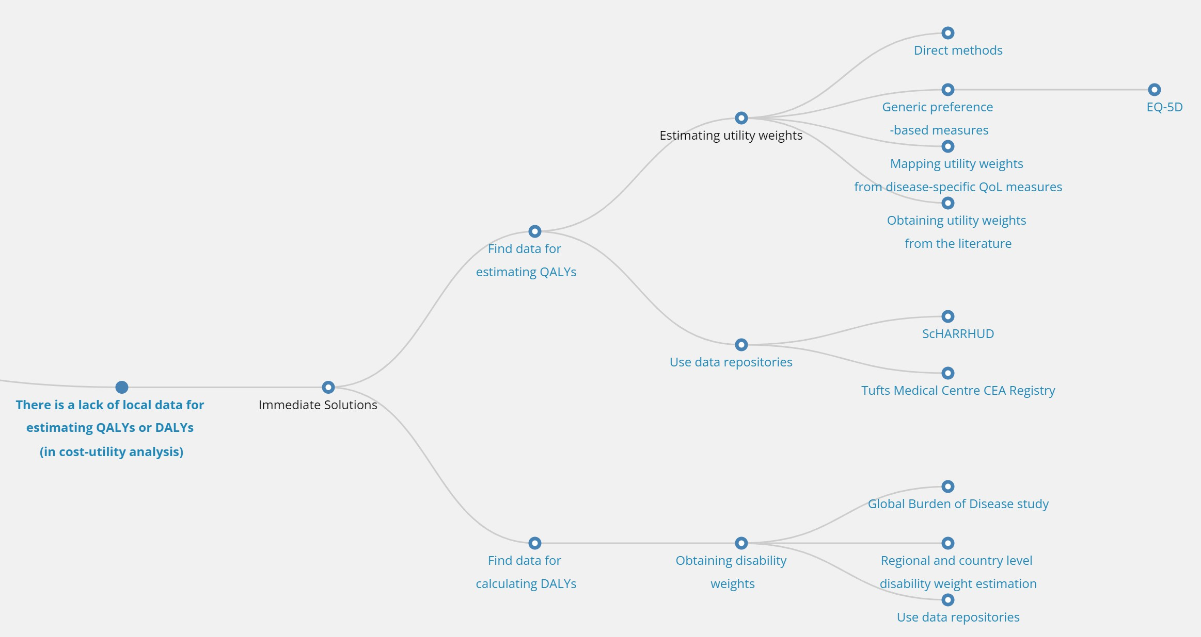
Resources
GEAR - Mind Map (gear4health.com)
38

Slide 39
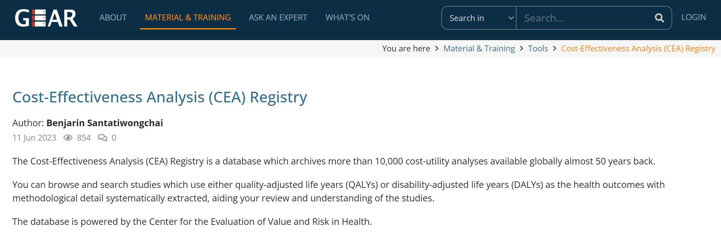
Resources
GEAR - Tools (gear4health.com)
39

Slide 40

Discussion
“A QALY is a QALY is a QALY”
Regional (or, context) specific measures
40

Slide 41
In Summary…
Type of Outcome | Unit of Measurement | Description | Example in Economic Evaluation | When Commonly Used
Natural Units | Cases prevented, deaths averted, life-years gained, hospitalizations avoided | Direct clinical or epidemiological outcomes that are easy to interpret. | Cost per malaria case prevented Cost per life-year saved | Early vaccine/drug trials, program evaluations with clear clinical endpoints
QALYs (Quality-Adjusted Life Years) | QALYs gained | Combines both the quantity and quality of life lived. One QALY = 1 year in perfect health. | Cost per QALY gained | High-income countries, health technology assessments, decisions involving quality of life
DALYs (Disability-Adjusted Life Years) | DALYs averted | Burden of disease measure combining years of life lost (YLL) and years lived with disability (YLD). Lower DALYs = better health. | Cost per DALY averted | Global health, LMIC (low- and middle-income countries), WHO cost-effectiveness thresholds
ICER (Incremental Cost-Effectiveness Ratio) | Cost per unit of outcome (e.g., cost per QALY gained, cost per DALY averted) | Compares the additional cost of an intervention relative to its additional benefit vs comparator. | $500 per DALY averted $10,000 per QALY gained | Used universally to summarize whether an intervention provides value for money
41

